Slide 1
Design and Implementation of Heterogeneous Sensor-based Embedded System for Flood Management
by Subhajit Sahu (110EC0181)
under the guidance of Prof. D. P. Acharya

Slide 2
Objective
To design and implement a modern, internet-based flood management system, that is simple, cost effective, easy to deploy and use.

Slide 3
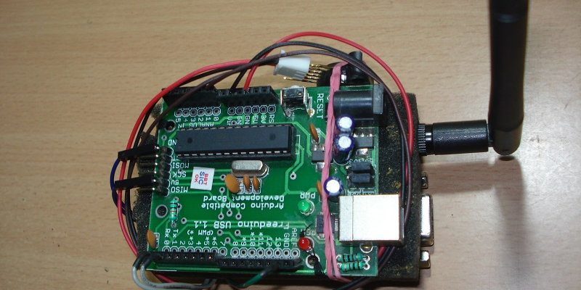
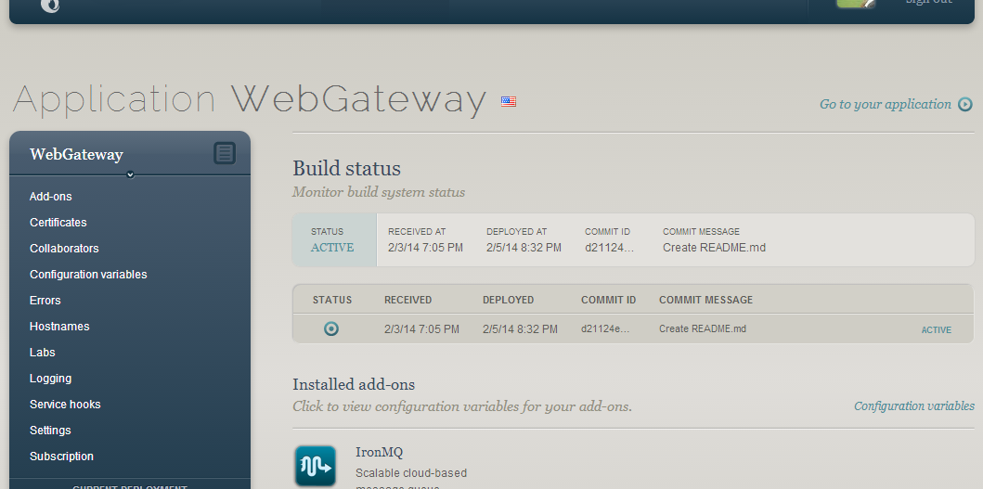
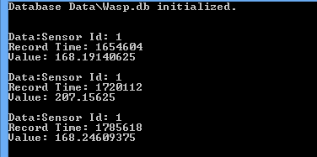
Project Output
Heterogeneous Sensor Module
Cloud-based Gateway
Local Host Storage Module
Wireless Sensor Module – (ATmega328, FLY900)
Firmware - (C++, Arduino)
Cloud Server Software - (C#, ASP.NET)
Local Host Software – (C#, SQLite)

Slide 4
Features
Low Power – 20mW
Low unit cost - ₹ 3000
Low usage cost - ₹ 20 / month
Compact and Portable
Easily Scalable
Simple to use

Slide 5
Project Description
Hardware Architecture
Software Architecture
System Data Flow
System on Single PCB

Slide 6
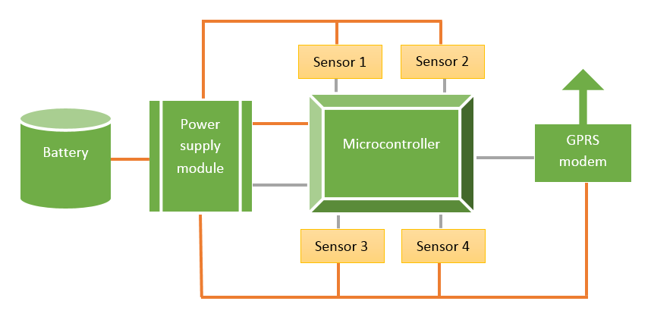
Hardware Architecture

Slide 7
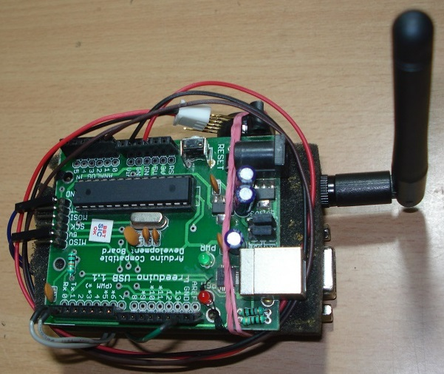
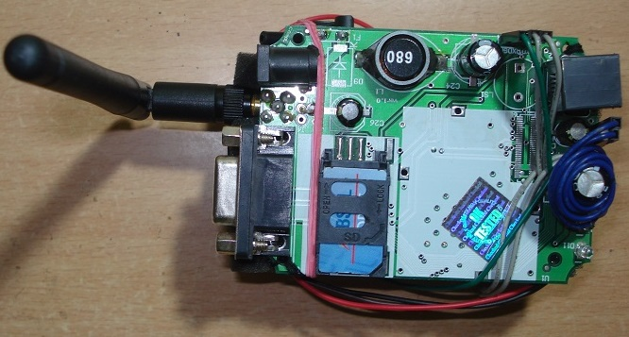
Hardware: Implementation
Microcontroller Side
Wireless GSM & GPRS Side

Slide 8
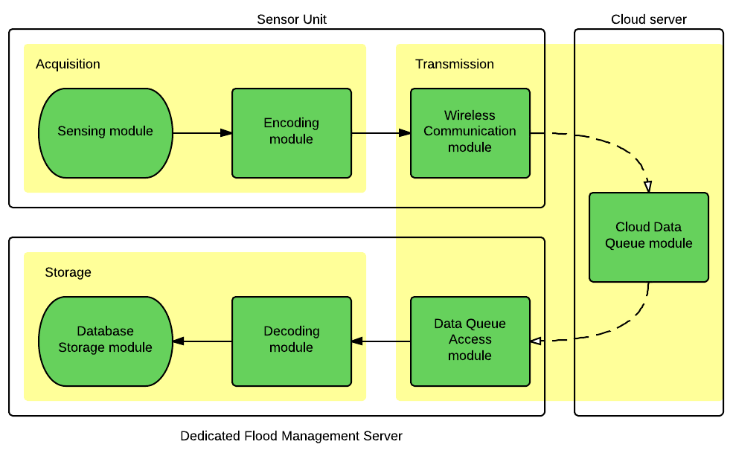
Software Architecture

Slide 9
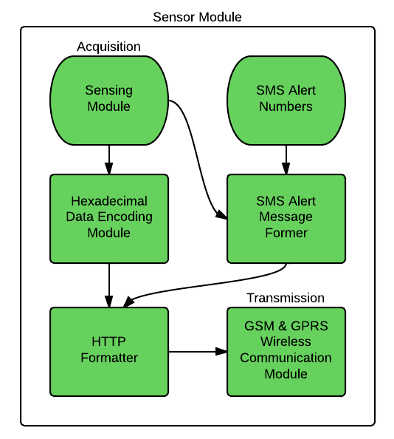
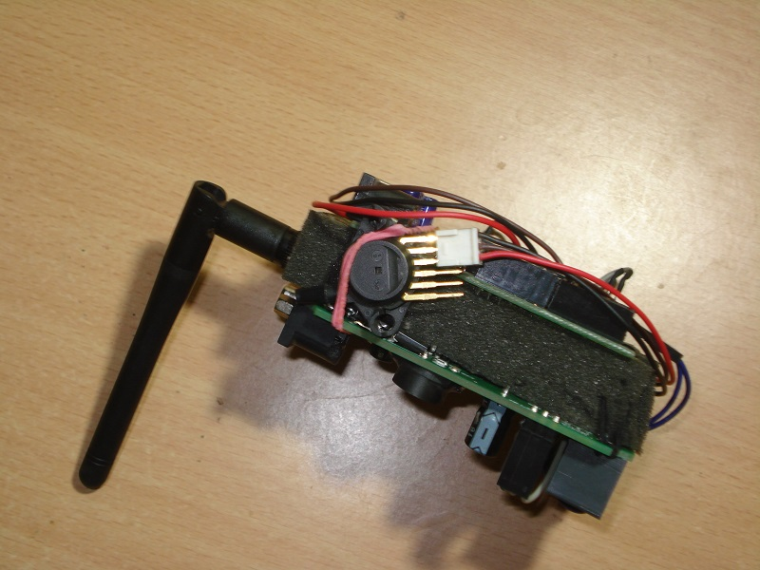
Data Flow: Origin
Block Diagram
Operation

Slide 10
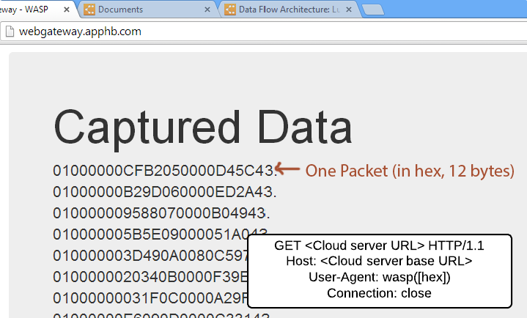
Data Flow: Encoding and Formatting
Block Diagram
Operation

Slide 11
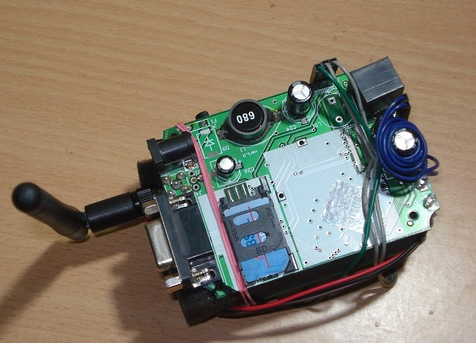
Data Flow: Wireless Transmission
Block Diagram
Operation

Slide 12
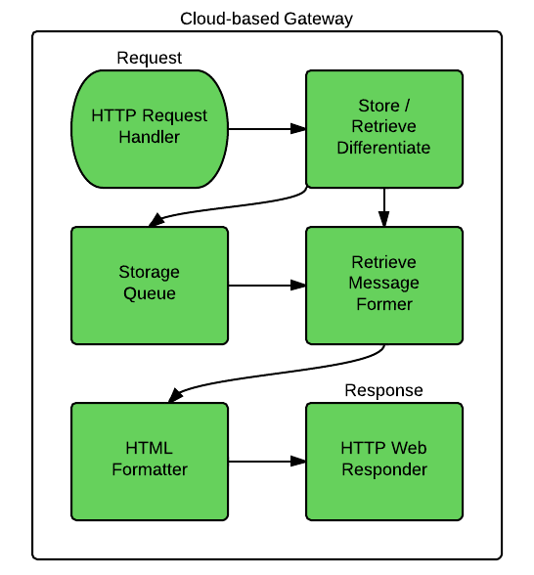
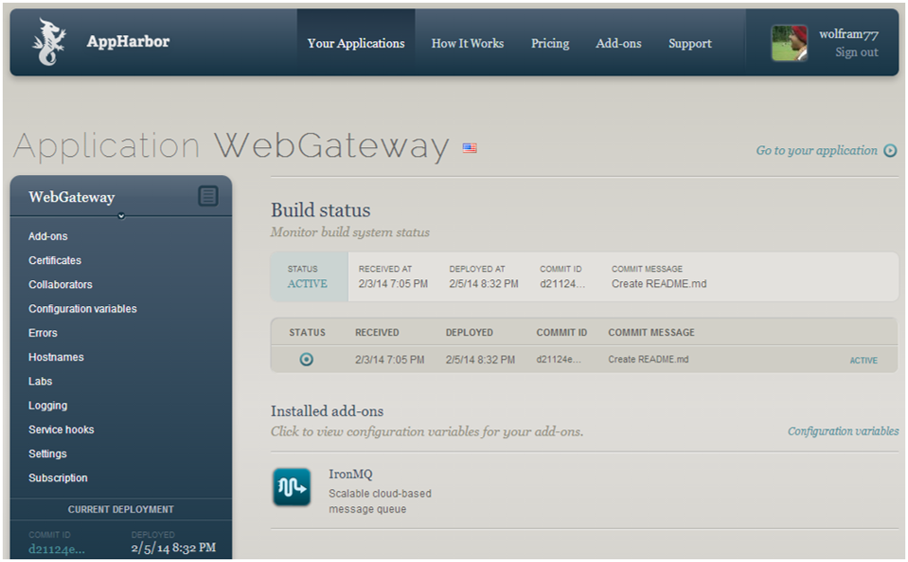
Data Flow: Intermediate Gateway
Block Diagram
Operation

Slide 13
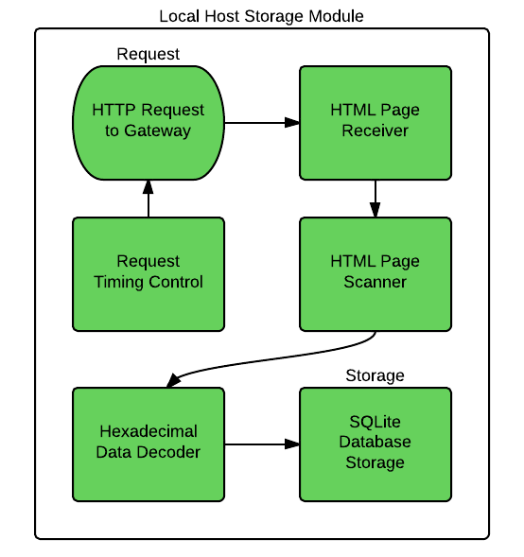

Data Flow: Retrieval from Gateway
Block Diagram
Operation

Slide 14
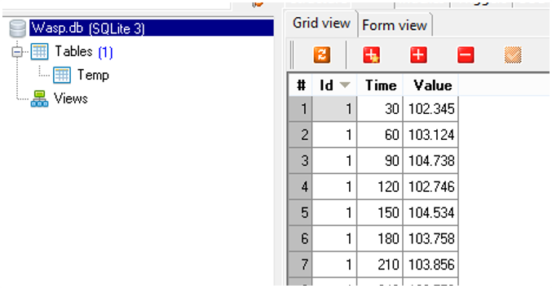
Data Flow: Storage to Database
Block Diagram
Operation

Slide 15
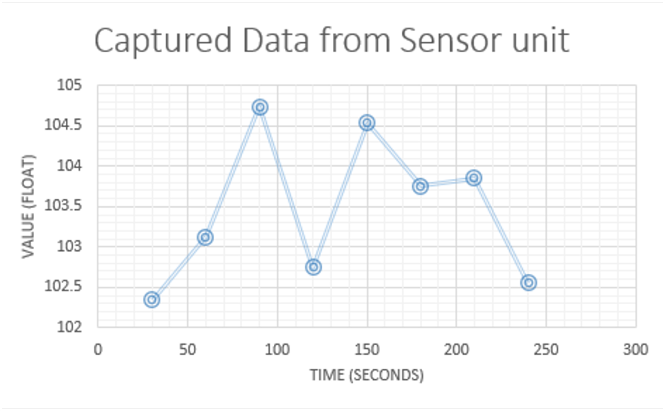
Data Flow: Data Visualization
Block Diagram
Operation

Slide 16
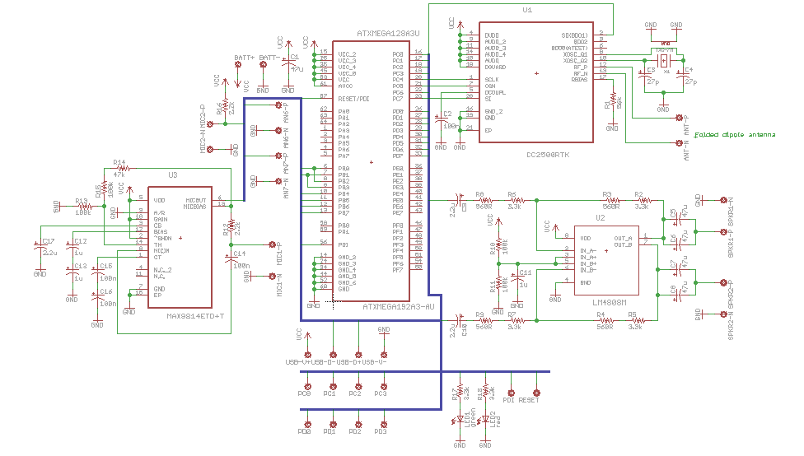
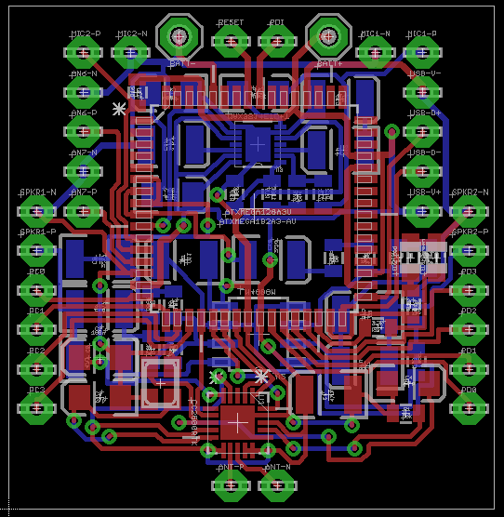
System on Single PCB: Design
Schematic Design
PC Board Layout

Slide 17

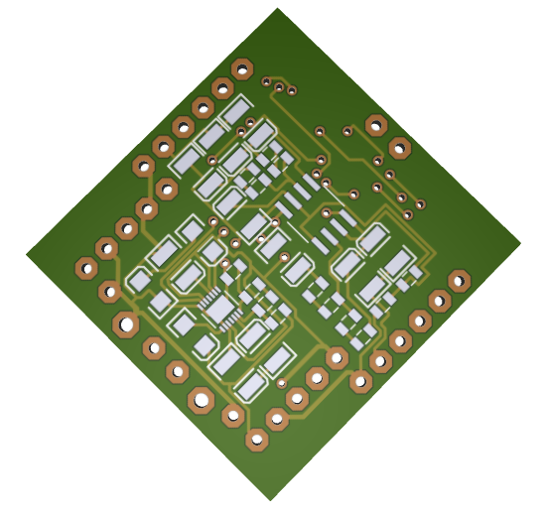
System on Single PCB: Design
Component Side - Gerber 3D
Solder Side - Gerber 3D

Slide 18
Software / IDEs used
Heterogeneous Sensor Module
Cloud-based Gateway
C / C++
Arduino IDE
Atmel Studio
.NET 4.5
Visual C#
Visual Studio

Slide 19
Software / IDEs used
Local Host Storage Module
Data Searching and Usage
SQLite
Visual C#
Visual Studio
SQLite Studio
SQLite
Excel

Slide 20
Conclusion
An internet-based heterogeneous-sensor flood management system was developed that measures a parameter (air pressure) and delivers it wirelessly, wherever desired (office).

Slide 21
Major References
Xiang Yang Li, K. W. Chau, Chun Tian Cheng, Y. S. Li. A Web-based flood forecasting system for Shuangpai region.Advances in Engineering Software 37 (2006), 146-158.
Bartosz Balis, Marek Kasztelnik, Marian Bubak, Tomasz Bartynski, Tomasz Gubala, Piotr Nowakowski, Jeroen Broekhuijsen. The UrbanFlood Common Information Space for Early Warning Systems. Internaltional Conference on Computational Science, ICCS 2011.
Ibrahim Demir, Witold F. Krajewski. Towards an Integrated Flood Information System: Centralized data access, analysis, and visualization. Environmental Modeling & Software 50 (2013), 77-84.
V.V. Krzhizhanovskaya, G.S. Shirshov, N.B. Melnikova, R.G. Belleman, F.I. Rusadi, B.J. Broekhuijsen, B.P. Gouldby, J. Lhomme, B. Balis, M. Bubak, A.L. Pyayt, I.I. Mokhov, A.V. Ozhigin, B. Lang, R.J. Meijer. Flood early warning system: design, implementation and computational modules. International Conference on Computational Science, ICCS 2011.
W. Al-Sabhan, M. Mulligan, G.A. Blackburn. A real-time hydrological model for flood prediction using GIS and the WWW. Computers, Environment and Urban Systems 27 (2003), 9-32.

Slide 22
Thank You

